Slide 1
C# 7
05 Jun 18 | Start
Appendix
Online

Slide 2
C# 7
Ch | Date
1 | 00 May 18
2
3
4
5
6
7
8
Pro C# 7 With .NET and .NET Core 2017 8th ed. Edition

Slide 3
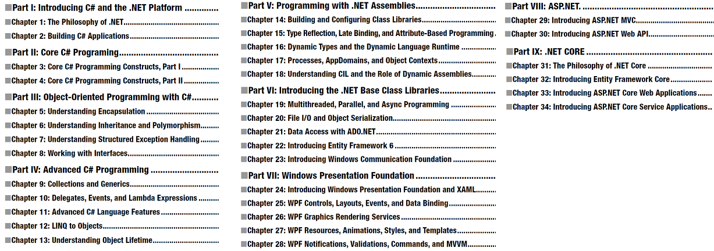

Slide 4
1

Slide 5
Intro

Slide 6
2

Slide 7
Intro

Slide 8
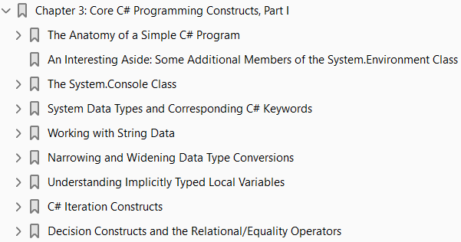
3

Slide 9
Intro

Slide 10
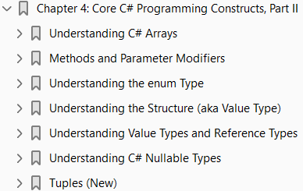
4
Core C# Programming Constructs, Part II

Slide 11
Intro
This chapter picks up where Chapter 3 left off and completes your investigation of the core aspects of the C# programming language.
You will start with an investigation of the details behind
manipulating arrays using the syntax of C# and
get to know the functionality contained within the related System.Array class type
Next, you will examine various details regarding
the construction of C# methods
exploring the
out
ref, and
params keywords.
Along the way, you will also examine the role of
optional and
named parameters

Slide 12
Intro |
I finish the discussion on methods with a look at method overloading.
Next, this chapter discusses the construction of
enumeration and
structure types
including a fairly detailed examination of the distinction between
a value type and
a reference type
This chapter wraps up by examining the role of
nullable data types and
the related operators
After you have completed this chapter, you will be in a perfect position to learn the object-oriented capabilities of C#, beginning in Chapter 5.

Slide 13
Understanding C# Arrays
As I would guess you are already aware, an array is a set of data items, accessed using a numerical index. More specifically, an array is a set of contiguous data points of the same type (an array of ints, an array of strings, an array of SportsCars, and so on). Declaring, filling, and accessing an array with C# are all quite straightforward. To illustrate, create a new Console Application project named FunWithArrays that contains a helper method named SimpleArrays(), invoked from within Main().
(Page 111).

Slide 14
C# Array Initialization Syntax
In addition to filling an array element by element, you are able to fill the items of an array using C# array initialization syntax. To do so, specify each array item within the scope of curly brackets ({}). This syntax can be helpful when you are creating an array of a known size and want to quickly specify the initial values. For example, consider the following alternative array declarations:
(Page 112).

Slide 15
Implicitly Typed Local Arrays
In Chapter 3, you learned about the topic of implicitly typed local variables. Recall that the var keyword allows you to define a variable, whose underlying type is determined by the compiler. In a similar vein, the var keyword can be used to define implicitly typed local arrays. Using this technique, you can allocate a new array variable without specifying the type contained within the array itself (note you must use the new keyword when using this approach).
(Page 113).

Slide 16
Defining an Array of Objects
In most cases, when you define an array, you do so by specifying the explicit type of item that can be within the array variable. While this seems quite straightforward, there is one notable twist. As you will come to understand in Chapter 6, System.Object is the ultimate base class to every type (including fundamental data types) in the .NET type system. Given this fact, if you were to define an array of System.Object data types, the subitems could be anything at all. Consider the following ArrayOfObjects() method (which again can be invoked from Main() for testing):
(Page 114).

Slide 20
Methods and Parameter Modifiers
To begin this section, let’s examine the details of defining methods. Just like the Main() method (see Chapter 3), your custom methods may or may not take parameters and may or may not return values to the caller. As you will see over the next several chapters, methods can be implemented within the scope of classes or structures (as well as prototyped within interface types) and may be decorated with various keywords
(Page 118).

Slide 28
The params Modifier
C# supports the use of parameter arrays using the params keyword.
To understand this language feature, you must (as the name implies) understand how to manipulate C# arrays. If this is not the case, you might want to return to this section after you read the section “Understanding C# Arrays” later in this chapter. The params keyword allows you to pass into a method a variable number of identically typed parameters (or classes related by inheritance) as a single logical parameter. As well, arguments marked with the params keyword can be processed if the caller sends in a strongly typed array or a comma- delimited list of items. Yes, this can be confusing! To clear things up, assume you want to create a function that allows the caller to pass in any number of arguments and return the calculated average. If you were to prototype this method to take an array of doubles, this would force the caller to first define the array, then fill the array, and finally pass it into the method. However, if you define CalculateAverage( )to take a params of double[] data types, the caller can simply pass a comma- delimited list of doubles. The .NET runtime will automatically package the set of doubles into an array of type double behind the scenes.
(Page 126).

Slide 38
5

Slide 39
Intro

Slide 40
6

Slide 41
Intro

Slide 42
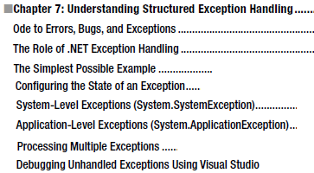
7
Exception Handling

Slide 43
Intro

Slide 44
8

Slide 45
Intro

Slide 46
9

Slide 47
Intro

Slide 48
10
Delegates, Events, and Lambda Expressions

Slide 49
Intro

Slide 50
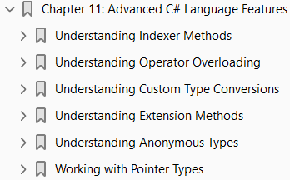
11
Advanced C# Language Features

Slide 51
Intro
In this chapter, you’ll deepen your understanding of the C# programming language by examining a number of more advanced topics.
To begin, you’ll learn how to implement and use an indexer method.
This C# mechanism enables you to build custom types that provide access to internal subitems using an array-like syntax.
After you learn how to build an indexer method, you’ll see
how to overload various operators (+, -, <, >, and so forth) and
how to create custom
explicit and
implicit conversion routines for your types (and you’ll learn why you might want to do this)
Next, you’ll examine topics that are particularly useful when working with LINQ-centric APIs (though you can use them outside of the context of LINQ)—specifically
extension methods and
anonymous types
To wrap things up, you’ll learn how to create an “unsafe” code context to directly manipulate unmanaged pointers.

Slide 52
Intro |
While it is certainly true that using pointers in C# applications is a fairly infrequent activity, understanding how to do so can be helpful in some circumstances that involve complex interoperability scenarios.

Slide 53
Understanding Indexer Methods
As a programmer, you are certainly familiar with the process of accessing individual items contained within a simple array using the index operator ([ ]).
Here’s an example:
This code is by no means a major news flash. However, the C# language provides the capability to design custom classes and structures that may be indexed just like a standard array, by defining an indexer method. This particular feature is most useful when you are creating custom collection classes (generic or nongeneric).
(Page 407).

Slide 54
Indexing Data Using String Values
The current PersonCollection class defined an indexer that allowed the caller to identify subitems using a numerical value. Understand, however, that this is not a requirement of an indexer method. Suppose you’d prefer to contain the Person objects using a System.Collections.Generic.Dictionary<TKey, TValue>
(Page 409).

Slide 58
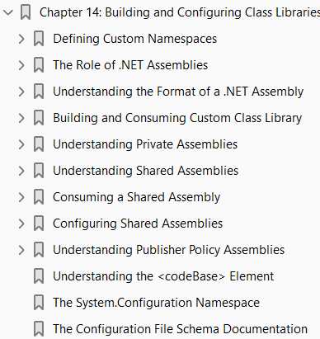
14
Building and Configuring Class Libraries

Slide 59
Intro
During the first four parts of this book, you have created a number of “stand-alone” executable applications, in which all the programming logic was packaged within a single executable file (*.exe).
These executable assemblies were using little more than the primary .NET class library, mscorlib.dll.
While some simple .NET programs may be constructed using nothing more than the .NET base class libraries, chances are it will be commonplace for you (or your teammates) to isolate reusable programming logic into custom class libraries (*.dll files) that can be shared among applications.
In this chapter, you will learn about various ways to package your types into custom libraries of code.
To begin, you’ll learn the details of partitioning types into .NET namespaces.
After this, you will examine the class library project templates of Visual Studio and learn the distinction between
private and
shared assemblies
Next, you’ll explore exactly how the .NET runtime resolves the location of an assembly, and you’ll come to understand the
global assembly cache

Slide 60
Intro |
XML application configuration files (*.config files)
publisher policy assemblies, and
the System.Configuration namespace

Slide 61
Defining Custom Namespaces
Before diving into the aspects of library deployment and configuration, the first task is to learn the details of packaging your custom types into .NET namespaces.
Up to this point in the text, you’ve been building small test programs that leverage existing namespaces in the .NET universe (System, in particular).
However, when you build larger applications with many types, it can be helpful to group your related types into custom namespaces.
In C#, this is accomplished using the namespace keyword.
Explicitly defining custom namespaces is even more important when creating .NET *.dll assemblies, as other developers will need to reference the library and import your custom namespaces to use your types.
To investigate the issues firsthand, begin by creating a new Console Application project named CustomNamespaces.
Now, assume you are developing a collection of geometric classes named Square, Circle, and Hexagon. Given their similarities, you would like to group them together into a unique namespace called MyShapes within the CustomNamespaces.exe assembly. You have two basic approaches. First, you can choose to define all classes in a single C# file (ShapesLib.cs) as follows:

Slide 62
Resolving Name Clashes - Fully Qualified Names
Technically speaking, you are not required to use the C# using keyword when referring to types defined in external namespaces. You could use the fully qualified name of the type, which, as you may recall from Chapter 1, is the type’s name prefixed with the defining namespace. Here’s an example:
(Page 511).

Slide 63
Resolving Name Clashes with Aliases
The C# using keyword also lets you create an alias for a type’s fully qualified name. When you do so, you define a token that is substituted for the type’s full name at compile time. Defining aliases provides a second way to resolve name clashes. Here’s an example: using System; using MyShapes; using My3DShapes;
(Page 513).

Slide 64
Creating Nested Namespaces
When organizing your types, you are free to define namespaces within other namespaces. The .NET base class libraries do so in numerous places to provide deeper levels of type organization. For example, the IO namespace is nested within System to yield System.IO. If you want to create a root namespace containing the existing My3DShapes namespace, you can update your code as follows:
(Page 514).

Slide 65
The Default Namespace of Visual Studio
On a final namespace-related note, it is worth pointing out that, by default, when you create a new C# project using Visual Studio, the name of your application’s default namespace will be identical to the project name. From this point on, when you insert new code files using the Project ➤ Add New Item menu selection, types will automatically be wrapped within the default namespace. If you want to change the name of the default namespace, simply access the “Default namespace” option using the Application tab of the project’s properties window (see Figure 14-1).
(Page 515).

Slide 66
The Role of .NET Assemblies
.NET applications are constructed by piecing together any number of assemblies. Simply put, an assembly is a versioned, self-describing binary file hosted by the CLR. Now, despite that .NET assemblies have the same file extensions (*.exe or *.dll) as previous Windows binaries, they have little in common with those files under the hood. Thus, to set the stage for the information to come, let’s consider some of the benefits provided by the assembly format.
(Page 516).

Slide 67
Assemblies Promote Code Reuse
As you have built your Console Application projects over the previous chapters, it might have seemed that all the applications’ functionality was contained within the executable assembly you were constructing. In reality, your applications were leveraging numerous types contained within the always-accessible .NET code library, mscorlib.dll (recall that the C# compiler references mscorlib.dll automatically), and in the case of some examples System.Core.dll. As you might know, a code library (also termed a class library) is a *.dll that contains types intended to be used by external applications. When you are creating executable assemblies, you will no doubt be leveraging numerous system-supplied and custom code libraries as you create your application. Do be aware, however, that a code library need not take a *.dll file extension. It is perfectly possible (although certainly not common) for an executable assembly to use types defined within an external executable file. In this light, a referenced *.exe can also be considered a code library. Regardless of how a code library is packaged, the .NET platform allows you to reuse types in a languageindependent manner. For example, you could create a code library in C# and reuse that library in any other .NET programming language. It is possible not only to allocate types across languages but also to derive from them. A base class defined in C# could be extended by a class authored in Visual Basic. Interfaces defined in F# can be implemented by structures defined in C#, and so forth. The point is that when you begin to break apart a single monolithic executable into numerous .NET assemblies, you achieve a language-neutral form of code reuse.
(Page 517).

Slide 68
Assemblies Establish a Type Boundary
Recall that a type’s fully qualified name is composed by prefixing the type’s namespace (e.g., System) to its name (e.g., Console). Strictly speaking, however, the assembly in which a type resides further establishes a type’s identity. For example, if you have two uniquely named assemblies (say, MyCars.dll and YourCars.dll) that both define a namespace (CarLibrary) containing a class named SportsCar, they are considered unique types in the .NET universe.
(Page 517).

Slide 69
Assemblies Are Versionable Units
.NET assemblies are assigned a four-part numerical version number of the form <major>.<minor>.<buil d>.<revision>. (If you do not explicitly provide a version number, the assembly is automatically assigned a version of 1.0.0.0, given the default Visual Studio project settings.) This number, in conjunction with an optional public key value, allows multiple versions of the same assembly to coexist in harmony on a single machine. Formally speaking, assemblies that provide public key information are termed strongly named. As you will see in this chapter, by using a strong name, the CLR is able to ensure that the correct version of an assembly is loaded on behalf of the calling client.
(Page 517).

Slide 70
Assemblies Are Self-Describing
Assemblies are regarded as self-describing, in part because they record every external assembly they must have access to in order to function correctly. Thus, if your assembly requires System.Windows.Forms. dll and System.Core.dll, this will be documented in the assembly’s manifest. Recall from Chapter 1 that a manifest is a blob of metadata that describes the assembly itself (name, version, required external assemblies, etc.).
(Page 517).

Slide 71
Assemblies Are Configurable
Assemblies can be deployed as “private” or “shared.” Private assemblies reside in the same directory (or possibly a subdirectory) as the client application that uses them. Shared assemblies, on the other hand, are libraries intended to be consumed by numerous applications on a single machine and are deployed to a specific directory termed the global assembly cache, or GAC. Regardless of how you deploy your assemblies, you are free to author XML-based configuration files. Using these configuration files, you can instruct the CLR to “probe” for assemblies at a specific location, load a specific version of a referenced assembly for a particular client, or consult an arbitrary directory on your local machine, your network location, or a web-based URL. You’ll learn a good deal more about XML configuration files throughout this chapter.
(Page 518).

Slide 72
Understanding the Format of a .NET Assembly
Now that you’ve learned about several benefits provided by the .NET assembly, let’s shift gears and get a better idea of how an assembly is composed under the hood. Structurally speaking, a .NET assembly (*.dll or *.exe) consists of the following elements: • A Windows file header • A CLR file header • CIL code • Type metadata • An assembly manifest • Optional embedded resources While the first two elements (the Windows and CLR headers) are blocks of data you can typically always ignore, they do deserve some brief consideration. Here’s an overview of each element.
(Page 518).

Slide 73
The Windows File Header
The Windows file header establishes the fact that the assembly can be loaded and manipulated by the Windows family of operating systems. This header data also identifies the kind of application (consolebased, GUI-based, or *.dll code library) to be hosted by Windows. If you open a .NET assembly using the dumpbin.exe utility (via a Windows command prompt) and specify the /headers flag as so:
(Page 518).

Slide 74
The CLR File Header
The CLR header is a block of data that all .NET assemblies must support (and do support, courtesy of the C# compiler) to be hosted by the CLR. In a nutshell, this header defines numerous flags that enable the runtime to understand the layout of the managed file. For example, flags exist that identify the location of the metadata and resources within the file, the version of the runtime the assembly was built against, the value of the (optional) public key, and so forth. If you supply the /clrheader flag to dumpbin.exe like so:
(Page 520).

Slide 75
CIL Code, Type Metadata, Assembly Manifest
At its core, an assembly contains CIL code, which, as you recall, is a platform- and CPU-agnostic intermediate language. At runtime, the internal CIL is compiled on the fly using a just-in-time (JIT) compiler, according to platform- and CPU-specific instructions. Given this design, .NET assemblies can indeed execute on a variety of architectures, devices, and operating systems. (Although you can live a happy and productive life without understanding the details of the CIL programming language, Chapter 18 offers an introduction to the syntax and semantics of CIL.)
(Page 520).

Slide 76
Optional Assembly Resources
Finally, a .NET assembly may contain any number of embedded resources, such as application icons, image files, sound clips, or string tables. In fact, the .NET platform supports satellite assemblies that contain nothing but localized resources. This can be useful if you want to partition your resources based on a specific culture (English, German, etc.) for the purposes of building international software. The topic of building satellite assemblies is outside the scope of this text; consult the .NET 4.7 Framework documentation for information on satellite assemblies if you are interested.
(Page 521).

Slide 77
Building and Consuming Custom Class Library
To begin exploring the world of .NET class libraries, you’ll first create a *.dll assembly (named CarLibrary) that contains a small set of public types. To build a code library using Visual Studio, select the Class Library project workspace via the File ➤ New Project menu option (see Figure 14-2). After creating the project, delete the autogenerated file Class1.cs.
(Page 521).

Slide 78
Exploring the Manifest
Before using CarLibrary.dll from a client application, let’s check out how the code library is composed under the hood. Assuming you have compiled this project, load CarLibrary.dll into ildasm.exe via the File ➤ Open menu, and navigate to the \bin\Debug subdirectory of your CarLibrary project. When you are done, you should see your library displayed in the IL disassembler tool (see Figure 14-4).
(Page 524).

Slide 79
Exploring the CIL
Recall that an assembly does not contain platform-specific instructions; rather, it contains platformagnostic Common Intermediate Language (CIL) instructions. When the .NET runtime loads an assembly into memory, the underlying CIL is compiled (using the JIT compiler) into instructions that can be understood by the target platform. For example, back in ildasm.exe, if you double-click the TurboBoost() method of the SportsCar class, ildasm.exe will open a new window showing the CIL tokens that implement this method.
(Page 527).

Slide 80
Exploring the Type Metadata
Before you build some applications that use your custom .NET library, if you press the Ctrl+M keystroke combination in ildasm.exe, you can see the metadata for each type within the CarLibrary.dll assembly (see Figure 14-7).
(Page 528).

Slide 81
Building a C# Client Application
Because each of the CarLibrary types has been declared using the public keyword, other .NET applications are able to use them as well. Recall that you may also define types using the C# internal keyword (in fact, this is the default C# access mode). Internal types can be used only by the assembly in which they are defined. External clients can neither see nor create types marked with the internal keyword. To use your library’s functionality, create a new C# Console Application project named CSharpCarClient. After you have done so, set a reference to CarLibrary.dll using the Browse node of the Add Reference dialog box (if you compiled CarLibrary.dll using Visual Studio, your assembly is located in the \bin\Debug subdirectory of the CarLibrary project folder). At this point, you can build your client application to use the external types. Update your initial C# file as follows:
(Page 529).

Slide 82
Building a Visual Basic Client Application
Recall that the .NET platform allows developers to share compiled code across programming languages. To illustrate the language-agnostic attitude of the .NET platform, let’s create another Console Application project (VisualBasicCarClient), this time using Visual Basic (see Figure 14-9). Once you have created the project, set a reference to CarLibrary.dll using the Add Reference dialog box, which can be activated by the Project ➤ Add Reference menu option. Visual Studio remembers files that you have browsed for, and CarLibary.dll should be in your Recent list under the Browse tab.
(Page 530).

Slide 83
Cross-Language Inheritance in Action
An enticing aspect of .NET development is the notion of cross-language inheritance. To illustrate, let’s create a new Visual Basic class that derives from SportsCar (which was authored using C#). First, add a new class file to your current Visual Basic application (by selecting the Project ➤ Add Class menu option) named PerformanceCar.vb. Update the initial class definition by deriving from the SportsCar type using the Inherits keyword. Then, override the abstract TurboBoost() method using the Overrides keyword, like so:
(Page 532).

Slide 84
Understanding Private Assemblies
Technically speaking, the class libraries you’ve created thus far in this chapter have been deployed as private assemblies.
Private assemblies must be located within the same directory as the client application that’s using them (the application directory) or a subdirectory thereof.
Recall that when you add a reference to CarLibrary.dll while building the CSharpCarClient.exe and VisualBasicCarClient.exe applications, Visual Studio responded by placing a copy of CarLibrary.dll within the client’s application directory (at least, after the first compilation).
When a client program uses the types defined within this external assembly, the CLR simply loads the local copy of CarLibrary.dll.
Because the .NET runtime does not consult the system registry when searching for referenced assemblies, you can relocate the CSharpCarClient.exe (or VisualBasicCarClient. exe) and CarLibrary.dll assemblies to a new location on your machine and run the application (this is often termed Xcopy deployment).
Uninstalling (or replicating) an application that makes exclusive use of private assemblies is a no- brainer: simply delete (or copy) the application folder.
More important, you do not need to worry that the removal of private assemblies will break any other applications on the machine.

Slide 85
The Identity of a Private Assembly
The full identity of a private assembly consists of the friendly name and numerical version, both of which are recorded in the assembly manifest. The friendly name is simply the name of the module that contains the assembly’s manifest minus the file extension. For example, if you examine the manifest of the CarLibrary.dll assembly, you find the following:
(Page 533).

Slide 86
Understanding the Probing Process
The .NET runtime resolves the location of a private assembly using a technique called probing, which is much less invasive than it sounds. Probing is the process of mapping an external assembly request to the location of the requested binary file. Strictly speaking, a request to load an assembly may be either implicit or explicit. An implicit load request occurs when the CLR consults the manifest to resolve the location of an assembly defined using the .assembly extern tokens. Here’s an example:
(Page 533).

Slide 87
Configuring Private Assemblies
While it is possible to deploy a .NET application by simply copying all required assemblies to a single folder on the user’s hard drive, you will most likely want to define a number of subdirectories to group related content. For example, assume you have an application directory named C:\MyApp that contains CSharpCarClient.exe. Under this folder might be a subfolder named MyLibraries that contains CarLibrary.dll. Regardless of the intended relationship between these two directories, the CLR will not probe the MyLibraries subdirectory unless you supply a configuration file. Configuration files contain various XML elements that allow you to influence the probing process. Configuration files must have the same name as the launching application and take a *.config file extension, and they must be deployed in the client’s application directory. Thus, if you want to create a configuration file for CSharpCarClient.exe, it must be named CSharpCarClient.exe.config and be located (for this example) in the C:\MyApp directory. To illustrate the process, create a new directory on your C: drive named MyApp using Windows Explorer. Next, copy CSharpCarClient.exe and CarLibrary.dll to this new folder, and run the program by doubleclicking the executable. Your program should run successfully at this point. Now, create a new subdirectory in C:\MyApp named MyLibraries (see Figure 14-10) and move CarLibrary.dll to this location.
(Page 534).

Slide 88
The Role of the App.Config File
While you are always able to create XML configuration files by hand using your text editor of choice, Visual Studio allows you to create a configuration file during the development of the client program. By default a new Visual Studio project will contain a configuration file for editing. If you ever need to add one manually, you may do so via the Project ➤ Add New Item menu option. Notice in Figure 14-11, you have left the name of this file as the suggested App.config.
(Page 536).

Slide 89
Understanding Shared Assemblies
Now that you understand how to deploy and configure a private assembly, you can begin to examine the role of a shared assembly. Like a private assembly, a shared assembly is a collection of types intended for reuse among projects. The most obvious difference between shared and private assemblies is that a single copy of a shared assembly can be used by several applications on the same machine. Consider the fact that all the applications created in this text required access to mscorlib.dll. If you were to look in the application directory of each of these clients, you would not find a private copy of this .NET assembly. The reason is that mscorlib.dll has been deployed as a shared assembly. Clearly, if you need to create a machine-wide class library, this is the way to go.
(Page 538).

Slide 90
The Global Assembly Cache
As suggested in the previous paragraph, a shared assembly is not deployed within the same directory as the application that uses it. Rather, shared assemblies are installed into the GAC. However, the exact location of the GAC will depend on which versions of the .NET platform you installed on the target computer. Machines that have not installed .NET 4.0 or higher will find the GAC is located in a subdirectory of your Windows directory named assembly (e.g., C:\Windows\assembly). These days, you might consider this the “historical GAC,” as it can only contain .NET libraries compiled on versions 1.0, 2.0, 3.0, or 3.5. See Figure 14-13.
(Page 539).

Slide 91
Understanding Strong Names
Before you can deploy an assembly to the GAC, you must assign it a strong name, which is used to uniquely identify the publisher of a given .NET binary. Understand that a “publisher” can be an individual programmer (such as yourself), a department within a given company, or an entire company itself. In some ways, a strong name is the modern-day .NET equivalent of the COM globally unique identifier (GUID) identification scheme. If you have a COM background, you might recall that AppIDs are GUIDs that identify a particular COM application. Unlike COM GUID values (which are nothing more than 128-bit numbers), strong names are based (in part) on two cryptographically related keys (public keys and private keys), which are much more unique and resistant to tampering than a simple GUID. Formally, a strong name is composed of a set of related data, much of which is specified using the following assembly-level attributes: • The friendly name of the assembly (which, you recall, is the name of the assembly minus the file extension) • The version number of the assembly (assigned using the [AssemblyVersion] attribute) • The public key value (assigned using the [AssemblyKeyFile] attribute) • An optional culture identity value for localization purposes (assigned using the [AssemblyCulture] attribute) • An embedded digital signature, created using a hash of the assembly’s contents and the private key value
(Page 541).

Slide 92
Generating Strong Names - Command Line
Let’s walk through the process of assigning a strong name to the CarLibrary assembly created earlier in this chapter. These days, you will most likely generate the required *.snk file using Visual Studio. However, in the bad old days (circa 2003), the only option for strongly signing an assembly was to do so at the command line. Let’s see how to do this. The first order of business is to generate the required key data using the sn.exe utility. Although this tool has numerous command-line options, all you need to concern yourself with for the moment is the -k flag, which instructs the tool to generate a new file containing the public/private key information. Create a new folder on your C: drive named MyTestKeyPair and change to that directory using the developer command prompt. Next, issue the following command to generate a file named MyTestKeyPair.snk:
(Page 542).

Slide 93
Generating Strong Names Using Visual Studio
Visual Studio allows you to specify the location of an existing *.snk file using the project’s Properties window as well as generate a new *.snk file. To make a new *.snk file for the CarLibrary project, first double-click the Properties icon of the Solution Explorer and select the Signing tab. Next, select the “Sign the assembly” check box, and choose the <New…> option from the drop-down list (see Figure 14-17).
(Page 544).

Slide 94
Installing Strongly Named Assemblies - GAC
The final step is to install the (now strongly named) CarLibrary.dll into the GAC. While the preferred way to deploy assemblies to the GAC in a production setting is to create an installer package, the .NET Framework SDK ships with a command-line tool named gacutil.exe, which can be useful for quick tests.
(Page 546).

Slide 95
Consuming a Shared Assembly
When you are building applications that use a shared assembly, the only difference from consuming a private assembly is in how you reference the library using Visual Studio. In reality, there is no difference as far as the tool is concerned—you still use the Add Reference dialog box. When you need to reference a private assembly, you could use the Browse button to navigate to the correct subdirectory of the GAC. However, you can also simply navigate to the location of the strongly named assembly (such as the /bin/debug folder of a Class Library project) and reference the copy. Figure 14-21 shows the referenced library.
(Page 548).

Slide 96
Exploring the Manifest of SharedCarLibClient
Recall that when you generate a strong name for an assembly, the entire public key is recorded in the assembly manifest. On a related note, when a client references a strongly named assembly, its manifest records a condensed hash value of the full public key, denoted by the .publickeytoken tag. If you open the manifest of SharedCarLibClient.exe using ildasm.exe, you would find the following (your public key token value will of course differ, as it is computed based on the public key value):
(Page 550).

Slide 97
Configuring Shared Assemblies
Like private assemblies, shared assemblies can be configured using a client *.config file. Of course, because shared assemblies are deployed to a well-known location (the GAC), you don’t use the <privatePath> element as you did for private assemblies (although if the client is using both shared and private assemblies, the <privatePath> element may still exist in the *.config file). You can use application configuration files in conjunction with shared assemblies whenever you want to instruct the CLR to bind to a different version of a specific assembly, effectively bypassing the value recorded in the client’s manifest. This can be useful for a number of reasons. For example, imagine that you have shipped version 1.0.0.0 of an assembly and later discover a major bug. One corrective action would be to rebuild the client application to reference the correct version of the bug-free assembly (say, 1.1.0.0) and redistribute the updated client and new library to every target machine.
(Page 550).

Slide 98
Freezing the Current Shared Assembly
To illustrate how to dynamically bind to a specific version of a shared assembly, open Windows Explorer and copy the current version of the compiled CarLibrary.dll assembly (1.0.0.0) into a distinct subdirectory (I called mine CarLibrary Version 1.0.0.0) to symbolize the freezing of this version (see Figure 14-22).
(Page 551).

Slide 99
Building a Shared Assembly
Version 2.0.0.0 Now, open your existing CarLibrary project and update your code base with a new enum type named MusicMedia that defines the following four possible musical devices:
(Page 552).

Slide 100
Dynamically Redirecting to Specific Versions of a Shared Assembly
When you want to tell the CLR to load a version of a shared assembly other than the version listed in the manifest, you can build a *.config file that contains a <dependentAssembly> element. When doing so, you will need to create an <assemblyIdentity> subelement that specifies the friendly name of the assembly listed in the client manifest (CarLibrary, for this example) and an optional culture attribute (which can be assigned an empty string or omitted altogether if you want to use the default culture for the machine). Moreover, the <dependentAssembly> element will define a <bindingRedirect> subelement to define the version currently in the manifest (via the oldVersion attribute) and the version in the GAC to load instead (via the newVersion attribute). Update the current configuration file in the application directory of SharedCarLibClient named SharedCarLibClient.exe.config that contains the following XML data.
(Page 554).

Slide 101
Understanding Publisher Policy Assemblies
The next configuration issue you’ll examine is the role of publisher policy assemblies. As you’ve just seen, *.config files can be constructed to bind to a specific version of a shared assembly, thereby bypassing the version recorded in the client manifest. While this is all well and good, imagine you’re an administrator who now needs to reconfigure all client applications on a given machine to rebind to version 2.0.0.0 of the CarLibrary.dll assembly. Given the strict naming convention of a configuration file, you would need to duplicate the same XML content in numerous locations (assuming you are, in fact, aware of the locations of the executables using CarLibrary!). Clearly this would be a maintenance nightmare. Publisher policy allows the publisher of a given assembly (you, your department, your company, or what have you) to ship a binary version of a *.config file that is installed into the GAC along with the newest version of the associated assembly. The benefit of this approach is that client application directories do not need to contain specific *.config files. Rather, the CLR will read the current manifest and attempt to find the requested version in the GAC. However, if the CLR finds a publisher policy assembly, it will read the embedded XML data and perform the requested redirection at the level of the GAC.
(Page 555).

Slide 102
Disabling Publisher Policy
Now, assume you (as a system administrator) have deployed a publisher policy assembly (and the latest version of the related assembly) to the GAC of a client machine. As luck would have it, nine of the ten affected applications rebind to version 2.0.0.0 without error. However, the remaining client application (for whatever reason) blows up when accessing CarLibrary.dll 2.0.0.0. (As we all know, it is next to impossible to build backward-compatible software that works 100 percent of the time.) In such a case, it is possible to build a configuration file for a specific troubled client that instructs the CLR to ignore the presence of any publisher policy files installed in the GAC. The remaining client applications that are happy to consume the newest .NET assembly will simply be redirected via the installed publisher policy assembly. To disable publisher policy on a client-by-client basis, author a (properly named) *.config file that uses the <publisherPolicy> element and set the apply attribute to no. When you do so, the CLR will load the version of the assembly originally listed in the client’s manifest.
(Page 556).

Slide 103
Understanding the <codeBase> Element
Application configuration files can also specify codebases. The <codeBase> element can be used to instruct the CLR to probe for dependent assemblies located at arbitrary locations (such as network endpoints or an arbitrary machine path outside a client’s application directory). If the value assigned to a <codeBase> element is located on a remote machine, the assembly will be downloaded on demand to a specific directory in the GAC termed the download cache. Given what you have learned about deploying assemblies to the GAC, it should make sense that assemblies loaded from a <codeBase> element will need to be assigned a strong name (after all, how else could the CLR install remote assemblies to the GAC?). If you are interested, you can view the content of your machine’s download cache by supplying the /ldl option to gacutil.exe, like so:
(Page 557).

Slide 104
The System.Configuration Namespace
Currently, all of the *.config files shown in this chapter have made use of well-known XML elements that are read by the CLR to resolve the location of external assemblies. In addition to these recognized elements, it is perfectly permissible for a client configuration file to contain application-specific data that has nothing to do with binding heuristics. Given this, it should come as no surprise that the .NET Framework provides a namespace that allows you to programmatically read the data within a client configuration file. The System.Configuration namespace provides a small set of types you can use to read custom data from a client’s *.config file. These custom settings must be contained within the scope of an <appSettings>
(Page 558).

Slide 105
The Configuration File Schema Documentation
In this chapter, you were introduced to the role of XML configuration files. Here, you focused on a few settings you can add to the <runtime> element that control how the CLR will attempt to locate externally required libraries. As you work on upcoming chapters of this book (and as you move beyond this book and begin to build larger-scale software), you will quickly notice that use of XML configuration files is commonplace. To be sure, the .NET platform uses *.config files in numerous APIs. For example, in Chapter 23, you will see that Windows Communication Foundation (WCF) uses configuration files to establish complex network settings. Later in this text when you examine web development via ASP.NET, you’ll quickly note that the web.config file contains the same type of instructions as a desktop App.config file. Because a given .NET configuration file can contain a large number of instructions, you should be aware that the entire schema of this XML file is documented online. Either search for Configuration File Schema for the .NET Framework or navigate to https://docs.microsoft.com/en-us/dotnet/framework/configureapps/file-schema/.
(Page 560).

Slide 106
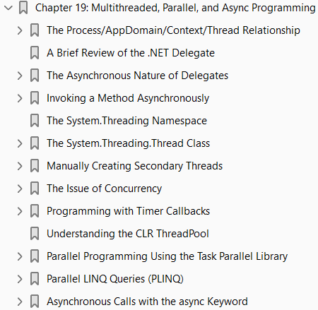
19
Multithreaded, Parallel, and Async Programming

Slide 107
Intro
Nobody enjoys working with an application that is sluggish during its execution. Moreover, nobody enjoys starting a task in an application (perhaps initiated by clicking a toolbar item) that prevents other parts of the program from being as responsive as possible. Before the release of .NET, building applications that had the ability to perform multiple tasks typically required authoring complex C++ code that used the Windows threading APIs. Thankfully, the .NET platform provides a number of ways for you to build software that can perform complex operations on unique paths of execution, with far fewer pain points. This chapter begins by defining the overall nature of a “multithreaded application.” Next, you will revisit the .NET delegate type to investigate its intrinsic support for asynchronous method invocations. As you’ll see, this technique allows you to invoke a method on a secondary thread of execution without needing to manually create or configure the thread itself. Next, you’ll be introduced to the original threading namespace that has shipped since .NET 1.0, specifically System.Threading. Here you’ll examine numerous types (Thread, ThreadStart, etc.) that allow you to explicitly create additional threads of execution and synchronize your shared resources, which helps ensure that multiple threads can share data in a nonvolatile manner. The remaining parts of this chapter will examine three more recent techniques .NET developers can use to build multithreaded software, specifically the Task Parallel Library (TPL), Parallel LINQ (PLINQ), and the new (as of C# 6) intrinsic asynchronous keywords of C# (async and await). As you will see, these features can dramatically simplify how you can build responsive multithreaded software applications.
(Page 701).

Slide 108
The Process/AppDomain/Context/Thread Relationship
In Chapter 17, a thread was defined as a path of execution within an executable application. While many .NET applications can live happy and productive single-threaded lives, an assembly’s primary thread (spawned by the CLR when Main() executes) may create secondary threads of execution at any time to perform additional units of work. By creating additional threads, you can build more responsive (but not necessarily faster executing on single-core machines) applications. The System.Threading namespace was released with .NET 1.0 and offers one approach to build multithreaded applications. The Thread class is perhaps the core type, as it represents a given thread. If you
(Page 701).

Slide 109
The Problem of Concurrency
One of the many “joys” (read: painful aspects) of multithreaded programming is that you have little control over how the underlying operating system or the CLR uses its threads. For example, if you craft a block of code that creates a new thread of execution, you cannot guarantee that the thread executes immediately. Rather, such code only instructs the OS/CLR to execute the thread as soon as possible (which is typically when the thread scheduler gets around to it).
(Page 702).

Slide 110
The Role of Thread Synchronization
At this point, it should be clear that multithreaded programs are in themselves quite volatile, as numerous threads can operate on the shared resources at (more or less) the same time. To protect an application’s resources from possible corruption, .NET developers must use any number of threading primitives (such as locks, monitors, and the [Synchronization] attribute or language keyword support) to control access among the executing threads. Although the .NET platform cannot make the difficulties of building robust multithreaded applications completely disappear, the process has been simplified considerably. Using types defined within the System.Threading namespace, the Task Parallel Library (TPL), and the C# async and await language keywords, you are able to work with multiple threads with minimal fuss and bother. Before diving into the System.Threading namespace, the TPL, and the C# async and await keywords, you will begin by examining how the .NET delegate type can be used to invoke a method in an asynchronous manner. While it is most certainly true that since .NET 4.6, the new C# async and await keywords offer a simpler alternative to asynchronous delegates, it is still important that you know how to interact with code using this approach (trust me; there is a ton of code in production that uses asynchronous delegates).
(Page 703).

Slide 111
A Brief Review of the .NET Delegate
Recall that a .NET delegate is essentially a type-safe, object-oriented, function pointer. When you define a .NET delegate type, the C# compiler responds by building a sealed class that derives from System.MulticastDelegate (which in turn derives from System.Delegate). These base classes provide every delegate with the ability to maintain a list of method addresses, all of which may be invoked at a later time. Consider the following BinaryOp delegate, first defined in Chapter 10:
(Page 703).

Slide 112
The Asynchronous Nature of Delegates
If you are new to the topic of multithreading, you might wonder what exactly an asynchronous method invocation is all about. As you are no doubt fully aware, some programming operations take time. Although the previous Add() was purely illustrative in nature, imagine that you built a single-threaded application that is invoking a method on a remote web service operation, calling a method performing a long-running database query, downloading a large document, or writing 500 lines of text to an external file. While performing these operations, the application could appear to hang for some amount of time. Until the task at hand has been processed, all other aspects of this program (such as menu activation, toolbar clicking, or console output) are suspended (which can aggravate users).
(Page 705).

Slide 113
The BeginInvoke() and EndInvoke() Methods
When the C# compiler processes the delegate keyword, the dynamically generated class defines two methods named BeginInvoke() and EndInvoke(). Given the definition of the BinaryOp delegate, these methods are prototyped as follows:
(Page 706).

Slide 114
The System.IAsyncResult Interface
The BeginInvoke() method always returns an object implementing the IAsyncResult interface, while EndInvoke() requires an IAsyncResult-compatible type as its sole parameter. The IAsyncResultcompatible object returned from BeginInvoke() is basically a coupling mechanism that allows the calling thread to obtain the result of the asynchronous method invocation at a later time via EndInvoke(). The IAsyncResult interface (defined in the System namespace) is defined as follows:
(Page 706).

Slide 115
Invoking a Method Asynchronously
To instruct the BinaryOp delegate to invoke Add() asynchronously, you will modify the logic in the previous project (feel free to add code to the existing project; however, in your lab downloads, you will find a new Console Application project named AsyncDelegate). Update the previous Main() method as follows:
(Page 707).

Slide 116
Synchronizing the Calling Thread
If you think carefully about the current implementation of Main(), you might realize that the time span between calling BeginInvoke() and EndInvoke() is clearly less than five seconds. Therefore, once Doing more work in Main()! prints to the console, the calling thread is now blocked and waiting for the secondary thread to complete before being able to obtain the result of the Add() method. Therefore, you are effectively making yet another synchronous call.
(Page 708).

Slide 117
The Role of the AsyncCallback Delegate
Rather than polling a delegate to determine whether an asynchronously invoked method has completed, it would be more efficient to have the secondary thread inform the calling thread when the task is finished. When you want to enable this behavior, you will need to supply an instance of the System.AsyncCallback delegate as a parameter to BeginInvoke(), which up until this point has been null. However, when you do supply an AsyncCallback object, the delegate will call the specified method automatically when the asynchronous call has completed.
(Page 709).

Slide 118
The Role of the AsyncResult Class
Currently, the AddComplete() method is not printing the actual result of the operation (adding two numbers). The reason is that the target of the AsyncCallback delegate (AddComplete(), in this example) does not have access to the original BinaryOp delegate created in the scope of Main(); therefore, you can’t call EndInvoke() from within AddComplete()!
(Page 711).

Slide 119
Passing and Receiving Custom State Data
The final aspect of asynchronous delegates you need to address is the final argument to the BeginInvoke() method (which has been null up to this point). This parameter allows you to pass additional state information to the callback method from the primary thread. Because this argument is prototyped as a System.Object, you can pass in any type of data whatsoever, as long as the callback method knows what to expect. Assume for the sake of demonstration that the primary thread wants to pass in a custom text message to the AddComplete() method, like so:
(Page 712).

Slide 120
The System.Threading Namespace
Under the .NET platform, the System.Threading namespace provides a number of types that enable the direct construction of multithreaded applications. In addition to providing types that allow you to interact with a particular CLR thread, this namespace defines types that allow access to the CLR- maintained thread pool, a simple (non-GUI-based) Timer class, and numerous types used to provide synchronized access to shared resources. Table 19-1 lists some of the important members of this namespace. (Be sure to consult the .NET Framework 4.7 SDK documentation for full details.)
(Page 713).

Slide 121
Obtaining Statistics About the Current Thread of Execution
Recall that the entry point of an executable assembly (i.e., the Main() method) runs on the primary thread of execution. To illustrate the basic use of the Thread type, assume you have a new Console Application project named ThreadStats. As you know, the static Thread.CurrentThread property retrieves a Thread object that represents the currently executing thread. Once you have obtained the current thread, you are able to print out various statistics, like so:
(Page 715).

Slide 122
The Name Property
While this code is more or less self-explanatory, do notice that the Thread class supports a property called Name. If you do not set this value, Name will return an empty string. However, once you assign a friendly string moniker to a given Thread object, you can greatly simplify your debugging endeavors. If you are using Visual Studio, you may access the Threads window during a debugging session (select Debug ➤ Windows ➤ Threads when the program is running). As you can see from Figure 19-1, you can quickly identify the thread you want to diagnose.
(Page 716).

Slide 123
The Priority Property
Next, notice that the Thread type defines a property named Priority. By default, all threads have a priority level of Normal. However, you can change this at any point in the thread’s lifetime using the ThreadPriority property and the related System.Threading.ThreadPriority enumeration, like so:
(Page 717).

Slide 124
Manually Creating Secondary Threads
When you want to programmatically create additional threads to carry on some unit of work, follow this predictable process when using the types of the System.Threading namespace: 1. Create a method to be the entry point for the new thread. 2. Create a new ParameterizedThreadStart (or ThreadStart) delegate, passing the address of the method defined in step 1 to the constructor. 3. Create a Thread object, passing the ParameterizedThreadStart/ThreadStart delegate as a constructor argument. 4. Establish any initial thread characteristics (name, priority, etc.). 5. Call the Thread.Start() method. This starts the thread at the method referenced by the delegate created in step 2 as soon as possible.
(Page 718).

Slide 125
Working with the ThreadStart Delegate
To illustrate the process of building a multithreaded application (as well as to demonstrate the usefulness of doing so), assume you have a Console Application project (SimpleMultiThreadApp) that allows the end user to choose whether the application will perform its duties using the single primary thread or whether it will split its workload using two separate threads of execution. Assuming you have imported the System.Threading namespace, your first step is to define a method to perform the work of the (possible) secondary thread. To keep focused on the mechanics of building multithreaded programs, this method will simply print out a sequence of numbers to the console window, pausing for approximately two seconds with each pass. Here is the full definition of the Printer class:
(Page 718).

Slide 126
Working with the ParameterizedThreadStart Delegate
Recall that the ThreadStart delegate can point only to methods that return void and take no arguments. While this might fit the bill in some cases, if you want to pass data to the method executing on the secondary thread, you will need to use the ParameterizedThreadStart delegate type. To illustrate, let’s re-create the logic of the AsyncCallbackDelegate project created earlier in this chapter, this time using the ParameterizedThreadStart delegate type. To begin, create a new Console Application project named AddWithThreads and import the System. Threading namespace. Now, given that ParameterizedThreadStart can point to any method taking a System.Object parameter, you will create a custom type containing the numbers to be added, like so:
(Page 720).

Slide 127
The AutoResetEvent Class
In these first few examples, you have used a few crude ways to inform the primary thread to wait until the secondary thread has completed. During your examination of asynchronous delegates, you used a simple bool variable as a toggle; however, this is not a recommended solution, as both threads can access the same point of data, and this can lead to data corruption. A safer but still undesirable alternative is to call Thread. Sleep() for a fixed amount of time. The problem here is that you don’t want to wait longer than necessary. One simple, and thread-safe, way to force a thread to wait until another is completed is to use the AutoResetEvent class. In the thread that needs to wait (such as a Main() method), create an instance of this class and pass in false to the constructor to signify you have not yet been notified. Then, at the point at which you are willing to wait, call the WaitOne() method. Here is the update to the Program class, which will do this very thing using a static-level AutoResetEvent member variable:
(Page 721).

Slide 128
Foreground Threads and Background Threads
Now that you have seen how to programmatically create new threads of execution using the System.Threading namespace, let’s formalize the distinction between foreground threads and background threads. • Foreground threads have the ability to prevent the current application from terminating. The CLR will not shut down an application (which is to say, unload the hosting AppDomain) until all foreground threads have ended. • Background threads (sometimes called daemon threads) are viewed by the CLR as expendable paths of execution that can be ignored at any point in time (even if they are currently laboring over some unit of work). Thus, if all foreground threads have terminated, any and all background threads are automatically killed when the application domain unloads. It is important to note that foreground and background threads are not synonymous with primary and worker threads. By default, every thread you create via the Thread.Start() method is automatically a foreground thread. Again, this means that the AppDomain will not unload until all threads of execution have completed their units of work. In most cases, this is exactly the behavior you require. For the sake of argument, however, assume that you want to invoke Printer.PrintNumbers() on a secondary thread that should behave as a background thread. Again, this means that the method pointed to by the Thread type (via the ThreadStart or ParameterizedThreadStart delegate) should be able to halt
(Page 722).

Slide 129
The Issue of Concurrency
When you build multithreaded applications, your program needs to ensure that any piece of shared data is protected against the possibility of numerous threads changing its value. Given that all threads in an AppDomain have concurrent access to the shared data of the application, imagine what might happen if multiple threads were accessing the same point of data. As the thread scheduler will force threads to suspend their work at random, what if thread A is kicked out of the way before it has fully completed its work? Thread B is now reading unstable data. To illustrate the problem of concurrency, let’s build another Console Application project named MultiThreadedPrinting. This application will once again use the Printer class created previously, but this time the PrintNumbers() method will force the current thread to pause for a randomly generated amount of time.
(Page 723).

Slide 130
Synchronization Using the C# lock Keyword
The first technique you can use to synchronize access to shared resources is the C# lock keyword. This keyword allows you to define a scope of statements that must be synchronized between threads. By doing so, incoming threads cannot interrupt the current thread, thus preventing it from finishing its work. The lock keyword requires you to specify a token (an object reference) that must be acquired by a thread to enter within the lock scope. When you are attempting to lock down a private instance-level method, you can simply pass in a reference to the current type, as follows:
(Page 726).

Slide 131
Synchronization Using the System.Threading.Monitor Type
The C# lock statement is really just a shorthand notation for working with the System.Threading.Monitor class. Once processed by the C# compiler, a lock scope actually resolves to the following (which you can verify using ildasm.exe):
(Page 728).

Slide 132
Synchronization Using the System.Threading.Interlocked Type
Although it always is hard to believe until you look at the underlying CIL code, assignments and simple arithmetic operations are not atomic. For this reason, the System.Threading namespace provides a type that allows you to operate on a single point of data atomically with less overhead than with the Monitor type. The Interlocked class defines the key static members shown in Table 19-4.
(Page 729).

Slide 133
Synchronization Using the [Synchronization] Attribute
The final synchronization primitive examined here is the [Synchronization] attribute, which is a member of the System.Runtime.Remoting.Contexts namespace. In essence, this class-level attribute effectively locks down all instance member code of the object for thread safety. When the CLR allocates objects attributed with [Synchronization], it will place the object within a synchronized context. As you might recall from Chapter 17, objects that should not be removed from a contextual boundary should derive from ContextBoundObject. Therefore, if you want to make the Printer class type thread-safe (without explicitly writing thread-safe code within the class members), you could update the definition as follows:
(Page 730).

Slide 134
Programming with Timer Callbacks
Many applications have the need to call a specific method during regular intervals of time. For example, you might have an application that needs to display the current time on a status bar via a given helper function. As another example, you might want to have your application call a helper function every so often to perform noncritical background tasks such as checking for new e-mail messages. For situations such as these, you can use the System.Threading.Timer type in conjunction with a related delegate named TimerCallback.
(Page 730).

Slide 135
Using a Stand-Alone Discard
In the previous example, the Timer variable isn’t used in any execution path, so it can be replaced with a discard, as follows:
(Page 732).

Slide 136
Understanding the CLR ThreadPool
The next thread-centric topic you will examine in this chapter is the role of the CLR thread pool. When you invoke a method asynchronously using delegate types (via the BeginInvoke() method), the CLR does not literally create a new thread. For purposes of efficiency, a delegate’s BeginInvoke() method leverages a pool of worker threads that is maintained by the runtime. To allow you to interact with this pool of waiting threads, the System.Threading namespace provides the ThreadPool class type.
(Page 732).

Slide 137
Parallel Programming Using the Task Parallel Library
At this point in the chapter, you have examined two programming techniques (using asynchronous delegates and via the members of System.Threading) that allow you to build multithreaded software. Recall that both of these approaches will work under any version of the .NET platform. Beginning with the release of .NET 4.0, Microsoft introduced a new approach to multithreaded application development using a parallel programming library termed the Task Parallel Library (TPL). Using the types of System.Threading.Tasks, you can build fine-grained, scalable parallel code without having to work directly with threads or the thread pool. This is not to say, however, that you will not use the types of System.Threading when you use the TPL. In reality, these two threading toolkits can work together quite naturally. This is especially true in that the System.Threading namespace still provides a majority of the synchronization primitives you examined previously (Monitor, Interlocked, and so forth). This being said, you will quite likely find that you will favor working with the TPL rather than the original System.Threading namespace, given that the same set of tasks can be performed in a more straightforward manner.
(Page 734).

Slide 138
The System.Threading.Tasks Namespace
Collectively speaking, the types of System.Threading.Tasks are referred to as the Task Parallel Library. The TPL will automatically distribute your application’s workload across available CPUs dynamically, using the CLR thread pool. The TPL handles the partitioning of the work, thread scheduling, state management, and other low-level details. The end result is that you can maximize the performance of your .NET applications, while being shielded from many of complexities of directly working with threads (see Figure 19-2).
(Page 735).

Slide 139
The Role of the Parallel Class
A key class of the TPL is System.Threading.Tasks.Parallel. This class supports a number of methods that allow you to iterate over a collection of data (specifically, an object implementing IEnumerable<T>) in a parallel fashion. If you were to look up the Parallel class in the .NET Framework 4.7 SDK documentation, you would see that this class supports two primary static methods, Parallel.For() and Parallel. ForEach(), each of which defines numerous overloaded versions. These methods allow you to author a body of code statements that will be processed in a parallel manner. In concept, these statements are the same sort of logic you would write in a normal looping construct (via the for or foreach C# keywords). The benefit is that the Parallel class will pluck threads from the thread pool (and manage concurrency) on your behalf.
(Page 735).

Slide 140
Data Parallelism with the Parallel Class
The first way to use the TPL is to perform data parallelism. Simply put, this term refers to the task of iterating over an array or collection in a parallel manner using the Parallel.For() or Parallel.ForEach() method. Assume you need to perform some labor-intensive file I/O operations. Specifically, you need to load a large number of *.jpg files into memory, flip them upside down, and save the modified image data to a new location. The .NET Framework 4.7 SDK documentation provides a console-based example of this very situation; however, you will see how to perform the same overall task using a graphical user interface so you can examine the use of “anonymous delegates” to allow secondary threads to update the primary user interface thread (aka the UI thread).
(Page 736).

Slide 141
Accessing UI Elements on Secondary Threads
You’ll notice that I’ve commented out the previous line of code that updated the caption of the main window with the ID of the currently executing thread. As noted previously, GUI controls have “thread affinity” with the thread that created them. If secondary threads attempt to access a control they did not directly create, you are bound to run into runtime errors when debugging your software. On the flip side, if you were to run the application (via Ctrl+F5), you might not ever find any problems whatsoever with the original code.
(Page 739).

Slide 142
The Task Class
The Task class allows you to easily invoke a method on a secondary thread and can be used as a simple alternative to working with asynchronous delegates. Update the Click handler of your Button control as so:
(Page 740).

Slide 143
Handling Cancellation Request
One improvement you can make to the current example is to provide a way for the user to stop the processing of the image data, via a second (aptly named) Cancel button. Thankfully, the Parallel.For() and Parallel.ForEach() methods both support cancellation through the use of cancellation tokens. When you invoke methods on Parallel, you can pass in a ParallelOptions object, which in turn contains a CancellationTokenSource object. First, define the following new private member variable in your Form-derived class of type CancellationTokenSource named cancelToken:
(Page 740).

Slide 144
Task Parallelism Using the Parallel Class
In addition to data parallelism, the TPL can also be used to easily fire off any number of asynchronous tasks using the Parallel.Invoke() method. This approach is a bit more straightforward than using delegates or members from System.Threading; however, if you require more control over the way tasks are executed, you could forgo use of Parallel.Invoke() and use the Task class directly, as you did in the previous example. To illustrate task parallelism, create a new console application called MyEBookReader and be sure the System.Threading, System.Threading.Tasks, and System.Net namespaces are imported at the top of Program.cs (this example is a modification of a useful example in the .NET Framework SDK documentation). Here, you will fetch a publicly available e-book from Project Gutenberg (www.gutenberg. org) and then perform a set of lengthy tasks in parallel. The book is downloaded in the GetBook() method, shown here:
(Page 742).

Slide 145
Parallel LINQ Queries (PLINQ)
To wrap up your look at the TPL, be aware that there is another way you can incorporate parallel tasks into your .NET applications. If you choose, you can use a set of extension methods that allow you to construct a LINQ query that will perform its workload in parallel (if possible). Fittingly, LINQ queries that are designed to run in parallel are termed PLINQ queries. Like parallel code authored using the Parallel class, PLINQ has the option of ignoring your request to process the collection in parallel if need be. The PLINQ framework has been optimized in numerous ways, which includes determining whether a query would, in fact, perform faster in a synchronous manner. At runtime, PLINQ analyzes the overall structure of the query, and if the query is likely to benefit from parallelization, it will run concurrently. However, if parallelizing a query would hurt performance, PLINQ just runs the query sequentially. If PLINQ has a choice between a potentially expensive parallel algorithm or an inexpensive sequential algorithm, it chooses the sequential algorithm by default. The necessary extension methods are found within the ParallelEnumerable class of the System.Linq namespace. Table 19-5 documents some useful PLINQ extensions.
(Page 745).

Slide 146
Opting in to a PLINQ Query
If you want to inform the TPL to execute this query in parallel (if possible), you will want to use the AsParallel() extension method as so:
(Page 746).

Slide 147
Cancelling a PLINQ Query
It is also possible to use a CancellationTokenSource object to inform a PLINQ query to stop processing under the correct conditions (typically because of user intervention). Declare a class-level CancellationTokenSource object named cancelToken and update the Main() method to take input from the user. Here is the relevant code update:
(Page 746).

Slide 148
Asynchronous Calls with the async Keyword
I have covered a lot of terse material in this (rather lengthy) chapter. To be sure, building, debugging, and understanding complex multithreaded applications are challenging in any framework. While the TPL, PLINQ, and the delegate type can simplify matters to some extent (especially when compared to other platforms and languages), developers are still required to be fairly savvy with the ins and outs of various advanced techniques. Since the release of .NET 4.5, the C# programming language (and for that matter, the VB programming language) has been updated with two new keywords that further simplify the process of authoring asynchronous code. In contrast to all the examples in this chapter, when you use the new async and await keywords, the compiler will generate a good deal of threading code on your behalf, using numerous members of the System.Threading and System.Threading.Tasks namespaces.
(Page 748).

Slide 149
A First Look at the C# async and await Keywords
The async keyword of C# is used to qualify that a method, lambda expression, or anonymous method should be called in an asynchronous manner automatically. Yes, it’s true. Simply by marking a method with the async modifier, the CLR will create a new thread of execution to handle the task at hand. Furthermore, when you are calling an async method, the await keyword will automatically pause the current thread from any further activity until the task is complete, leaving the calling thread free to continue on its merry way. To illustrate, create a console application named FunWithCSharpAsync and import the System. Threading and System.Threading.Tasks namespaces into Program.cs. Add a method named DoWork(), which forces the calling thread to wait for five seconds. Also, change the Main() method to async with a return type of Task (these will be explained shortly). Here is the story thus far:
(Page 748).

Slide 150
Naming Conventions for Asynchronous Methods
Of course, you noticed the name change from DoWork() to DoWorkAsync(), but why the change? Let’s say that the new version
(Page 750).

Slide 151
Async Methods Returning Void
Currently, your DoWorkAsync() method is returning a Task, which contains “real data” for the caller that will be obtained transparently via the await keyword. However, what if you want to build an asynchronous method that returns void? In this case, you use the nongeneric Task class and omit any return statement, like so:
(Page 750).

Slide 152
Async Methods with Multiple Awaits
It is completely permissible for a single async method to have multiple await contexts within its implementation. The following is perfectly acceptable code:
(Page 751).

Slide 153
Calling Async Methods from Non-async Methods
Each of the previous examples used the async keyword to return the thread to calling code while the async method executes. In review, you can only use the await keyword in a method marked async. What if you can’t (or don’t want to) mark a method async? Fortunately, there are other ways to call async methods. If you just don’t use await keyword, code in that method continues past the async method without returning to the caller. If you needed to actually wait for your async method to complete (which is what happens when you use the await keyword), you can call Result on the method. This is a property of the Task object; it waits for execution to complete and then returns the underlying data of the Task. For example, you could call the DoWorkAsync() method like this:
(Page 751).

Slide 154
Await in catch and finally Blocks
C# 6 introduced the ability to place await calls in catch and finally blocks. The method itself must be async to do this. The following code example demonstrates the capability:
(Page 752).

Slide 155
Generalized Async Return Types (New)
Prior to C# 7, the only return options for async methods were Task, Task<T>, and void. C# 7 enables additional return types, as long as they follow the async pattern. One concrete example is ValueTask, available in the System.Threading.Tasks.Extensions NuGet package. To install the package, open Package Manager Console (from View ➤ Other Windows) and enter the following:
(Page 752).

Slide 156
Local Functions (New)
Local functions were introduced in Chapter 4 and used in Chapter 8 with iterators. They can also be beneficial for async methods. To demonstrate the benefit, you need to first see the problem. Add a new method named MethodWithProblems() and add the following code:
(Page 753).

Slide 157
Wrapping Up async and await
This section contained a lot of examples; here are the key points of this section: • Methods (as well as lambda expressions or anonymous methods) can be marked with the async keyword to enable the method to do work in a nonblocking manner. • Methods (as well as lambda expressions or anonymous methods) marked with the async keyword will run synchronously until the await keyword is encountered. • A single async method can have multiple await contexts. • When the await expression is encountered, the calling thread is suspended until the awaited task is complete. In the meantime, control is returned to the caller of the method. • The await keyword will hide the returned Task object from view, appearing to directly return the underlying return value. Methods with no return value simply return void. • Parameter checking and other error handling should be done in the main section of the method, with the actual async portion moved to a private function. • For stack variables, the ValueTask is more efficient than the Task object, which might cause boxing and unboxing. • As a naming convention, methods that are to be called asynchronously should be marked with the Async suffix.
(Page 754).

Slide 158
File I/O and Object Serialization

Slide 159
Intro
When you create desktop applications, the ability to save information between user sessions is commonplace.
This chapter examines a number of I/O-related topics as seen through the eyes of the .NET Framework.
The first order of business is to
explore the core types defined in the System.IO namespace and
learn how to modify a machine’s
directory and
file structure programmatically
The next task is to explore various ways to read from and write to
character-based
binary-based
string-based, and
memory-based data stores
After you learn how to manipulate files and directories using the core I/O types, you will examine the related topic of object serialization.

Slide 160
Intro |
You can use object serialization to persist and retrieve the state of an object to (or from) any System.IO.Stream-derived type.
The ability to serialize objects is critical when you want to copy an object to a remote machine using various remoting technologies such as WCF.
However, serialization is quite useful in its own right and will likely play a role in many of your .NET applications (distributed or not).

Slide 161
Exploring the System.IO Namespace
In the framework of .NET, the System.IO namespace is the region of the base class libraries devoted to file-based (and memory-based) input and output (I/O) services.
Like any namespace, System.IO defines a set of classes, interfaces, enumerations, structures, and delegates, most of which you can find in mscorlib.dll.
In addition to the types contained within mscorlib.dll, the System.dll assembly defines additional members of the System.IO namespace.
Note that all Visual Studio projects automatically set a reference to both assemblies.
Many of the types within the System.IO namespace focus on the programmatic manipulation of physical directories and files.
However, additional types provide support to
read data from and write data to string buffers
as well as raw memory locations.
Table 20-1 outlines the core (nonabstract) classes, providing a road map of the functionality in System.IO.
In addition to these concrete class types, System.IO defines
a number of enumerations

Slide 162
Exploring the System.IO Namespace |
as well as a set of abstract classes (e.g., Stream, TextReader, and TextWriter)
that define a shared polymorphic interface to all descendants.
You will read about many of these types in this chapter.

Slide 163
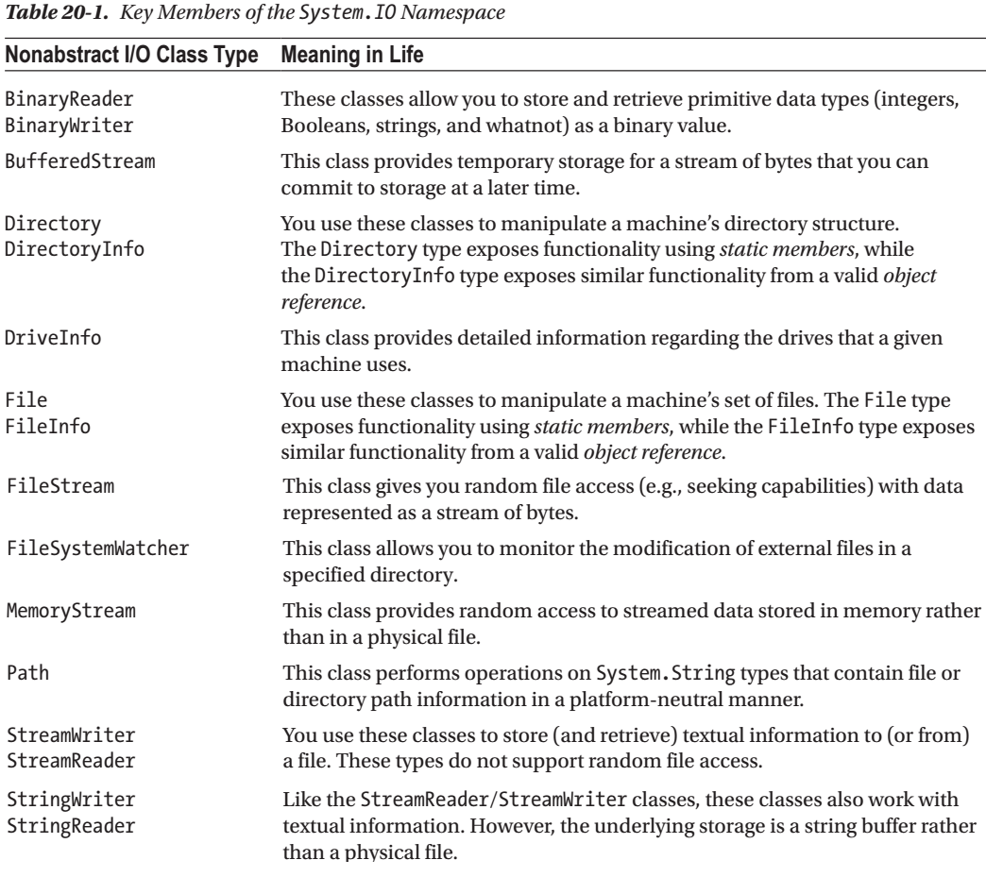
Table 20-1

Slide 164
The Directory(Info) and File(Info) Types
System.IO provides four classes that allow you to
manipulate individual files
as well as interact with a machine’s directory structure
The first two types,
Directory and
File
expose
Creation
Deletion
copying, and
moving operations using various static members
The closely related FileInfo and DirectoryInfo types expose similar functionality as instance-level methods (therefore, you must allocate them with the new keyword).
In Figure 20-1, the Directory and File classes directly extend System.Object, while DirectoryInfo and FileInfo derive from the abstract FileSystemInfo type.

Slide 165
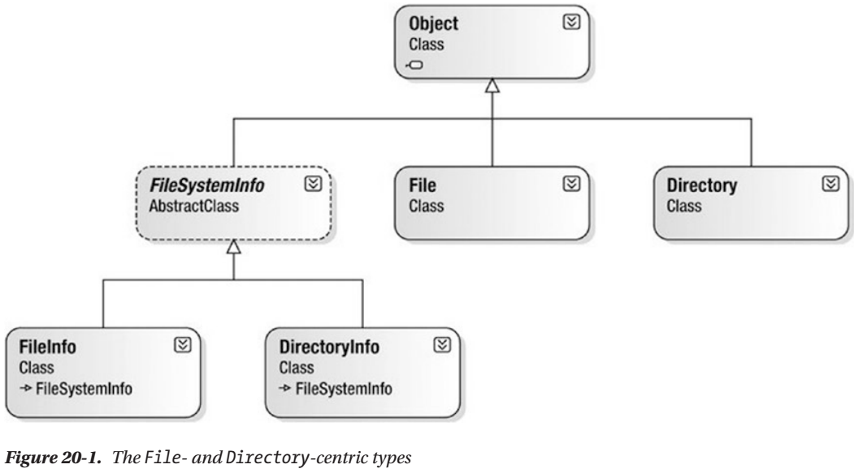
Figure 20-1

Slide 168
Understanding Object Serialization
The term serialization describes the process of persisting (and possibly transferring) the state of an object into a stream
file stream and
memory stream
The persisted data sequence contains all the necessary information you need to reconstruct (or deserialize) the state of the object for use later.
Using this technology makes it trivial to save vast amounts of data (in various formats).
In many cases, saving application data using serialization services results in less code than using the readers/writers you find in the System.IO namespace.
For example, assume you want to create a GUI-based desktop application that provides a way for end users to save their preferences (e.g., window color and font size).
To do this, you might define a class named UserPrefs that encapsulates 20 or so pieces of field data.
Now, if you were to use a System.IO.BinaryWriter type, you would need to save each field of the UserPrefs object manually.

Slide 169
Understanding Object Serialization |
Likewise, if you were to load the data from a file back into memory, you would need to use a System.IO.BinaryReader and (once again) manually read in each value to reconfigure a new UserPrefs object.
This is all doable, but you can save yourself a good amount of time by marking the UserPrefs class with the [Serializable] attribute, like so:

